Slide 1
A smart risky drivers identification system
Presented by :ROHIT SHARMA

Slide 2
Problem Statement
We Need to Spot Risky Drivers Early. Right now, the system only punishes drivers after they break rules. But it doesn’t track how often a driver breaks rules. How serious their mistakes are If they keep repeating the same mistakes . So these risky drivers are posing threat not only to themselves but also to other persons on road.

Slide 3
Dataset Overview
01
Total records
04
Violation history
4000 records
Fine Amount ,Previous Violations
02
Driver Profile
Environmental Data
05
Age ,Gender , License Type
Road Condition, Weather Condition
03
Vehicle Details
06
Behavior Indicators
Type, Model year , color
Helmet , Seatbelt worn, Alcohol Level

Slide 4
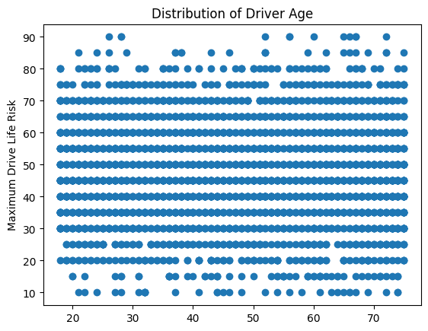
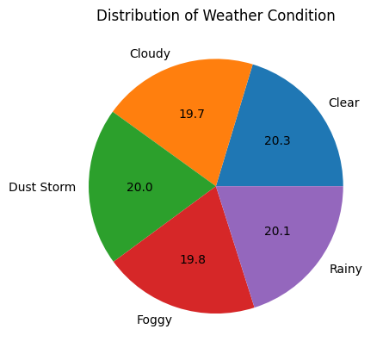
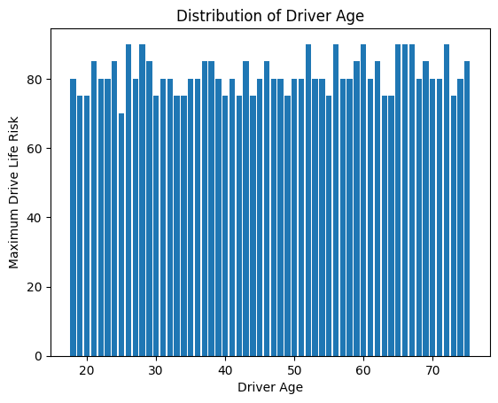
Data Visualisation

Slide 5
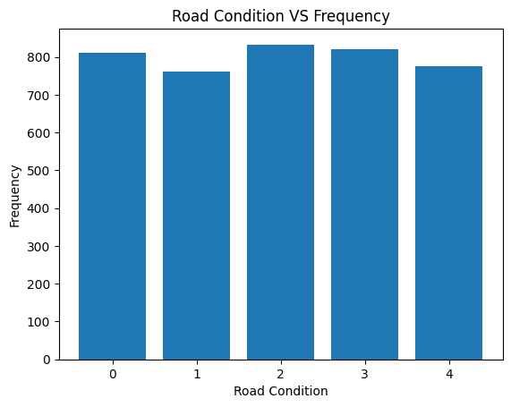
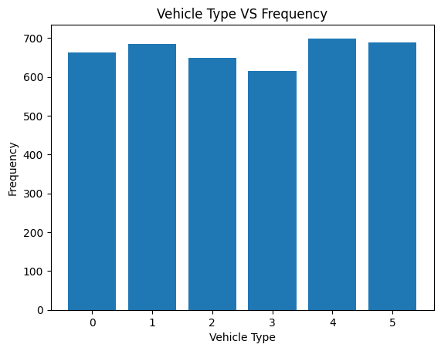
Data Visualisation

Slide 6
Data Preprocessing
Filling Missing Values
Fill Seatbelt/Helmet Worn
Encoding
Encode Gender , Vehicle Type ,Conditions
Normalization
Age, Speed ,Alcohol , Fines
Drop Irrelevant columns
ID , Comments , Vehicle Color

Slide 7
Feature Engineering : Created New Feature
01
Speeding Security
Is Drunk
02
Recorded Speed – Speed Limit
Alcohol Level >0.08
03
Over Speeding
Boolean flag

Slide 8
Splitting Data into Train and Test Data
01
02
Train Data
Test Data
3200 rows (80% Data)
800 rows (20% Data)

Slide 9
Training Models
01
Linear Regression
ML
KNN Regressor
02
Models
03
Decision Tree
SV Regressor
04
05
MLP Regressor
Random Forest
06
07
Gradient Boosting
Extra Trees Regressor
08

Slide 10
Models Evaluation
Model | R2 Score | Mean Absolute Error | Mean Squared Error
Random Forest | 0.8283 | 5.278 | 40.110
Linear Regression | 0.8251 | 5.146 | 40.626
Decision Tree | 0.8022 | 5.614 | 45.952
MLP | 0.8548 | 4.802 | 33.735
Gradient Boosting | 0.8912 | 4.376 | 25.261
KNN | 0.6399 | 7.404 | 83.666
SVR | 0.1593 | 11.613 | 195.358
Extra Tree | 0.8241 | 5.234 | 40.915

Slide 11
Conclusions
01
Young Drivers have high driver risk value.
02
Drunk driver are more risky.
Overspeed driver poses risk
03
ML

Slide 12
Thank You

